Slide 1
Real-time forecasts of the COVID-19 epidemic in China from February 5th to February 24th, 2020
Gwangwoo Kim
Dec. 16, 2022

Slide 2
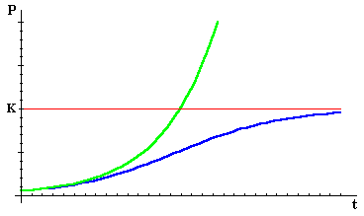

Logistic growth model
Simple growth model: $\frac{dC}{dt}=rC$.
The population is constrained by limitations on resources (i.e., $C(t)<K)$

Slide 3
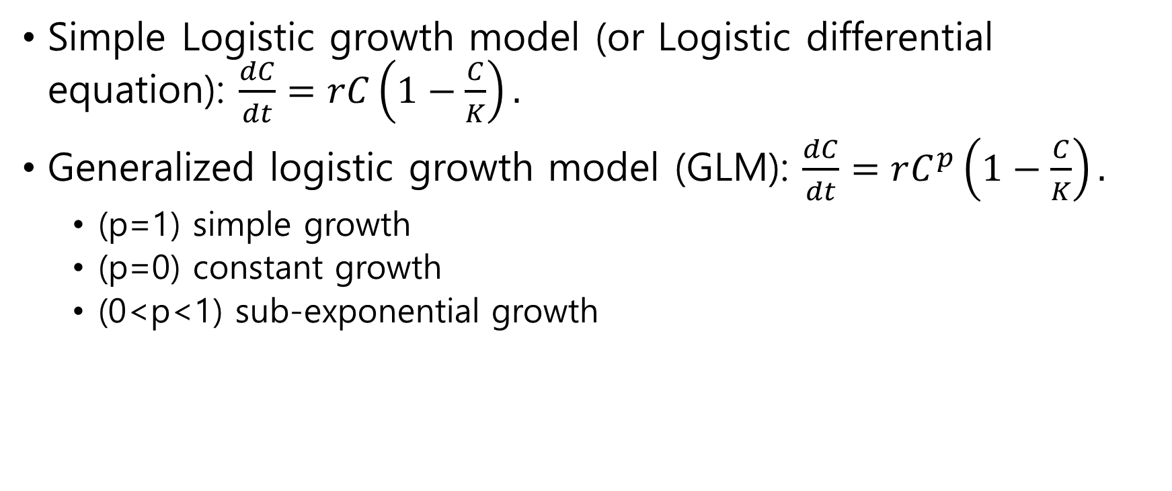
Logistic growth model
Simple Logistic growth model (or Logistic differential equation): $\frac{dC}{dt}=rC\left(1−\frac{C}{K}\right).$
Generalized logistic growth model (GLM): $\frac{dC}{dt}=rC^{p}\left(1−\frac{C}{K}\right).$
(p=1) simple growth
(p=0) constant growth
(0<p<1) sub-exponential growth

Slide 4
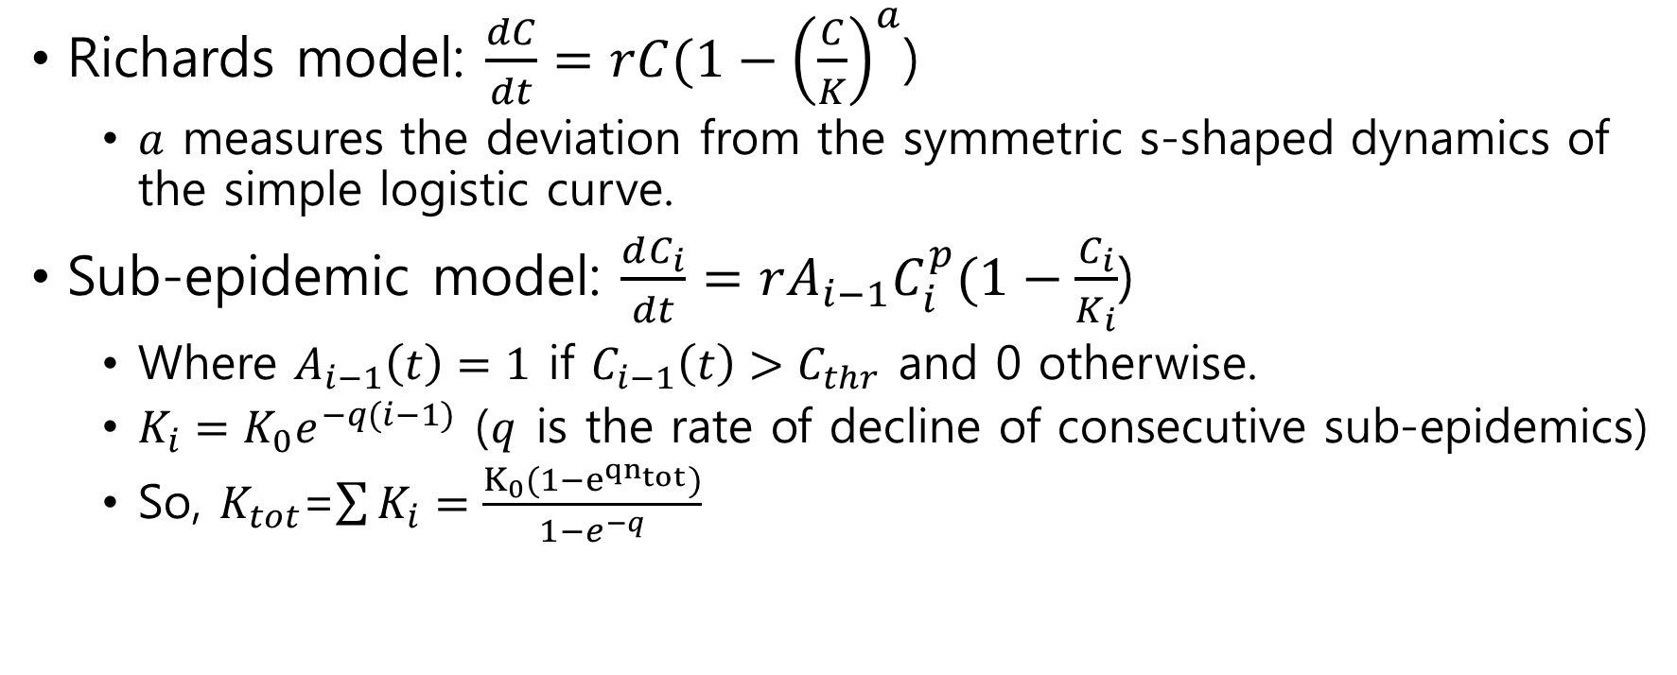
Logistic growth model
Richards model: $\frac{dC}{dt}=rC(1−{\left(\frac{C}{K}\right)}^{a}$)
$a$ measures the deviation from the symmetric s-shaped dynamics of the simple logistic curve.
Sub-epidemic model: $\frac{dC_{i}}{dt}=r{A_{i−1}C}_{i}^{p}(1−\frac{C_{i}}{K_{i}}$)
Where $A_{i−1}\left(t\right)=1$ if $C_{i−1}\left(t\right)>C_{thr}$ and 0 otherwise.
$K_{i}=K_{0}e^{−q(i−1)}$ ($q$ is the rate of decline of consecutive sub-epidemics)
So, $K_{tot}$=$\sum{K_{i}}=\frac{K_{0}(1−e^{{qn}_{tot}})}{1−e^{−q}}$

Slide 5
Data description
We obtained daily updates of the cumulative number of reported confirmed cases for the 2019-nCoV epidemic.
We refer to the regions collectively as provinces.
The short time-series is affected by irregularities and reporting lags.

Slide 6
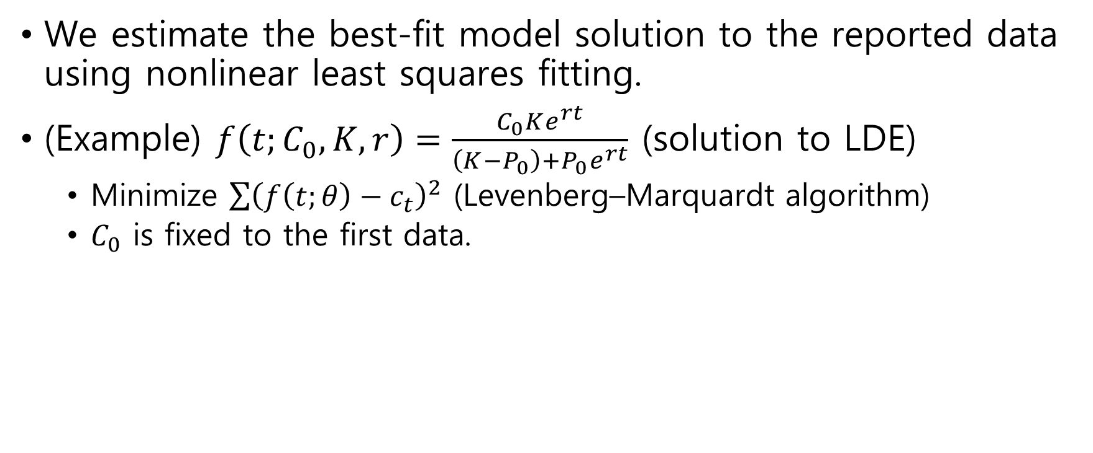
Parameter estimation
We estimate the best-fit model solution to the reported data using nonlinear least squares fitting.
(Example) $f\left(t;C_{0},K,r\right)=\frac{C_{0}Ke^{rt}}{\left(K−P_{0}\right)+P_{0}e^{rt}}$ (solution to LDE)
Minimize $\sum{{\left(f\left(t;θ\right)−c_{t}\right)}^{2}}$ (Levenberg–Marquardt algorithm)
$C_{0}$ is fixed to the first data.

Slide 7
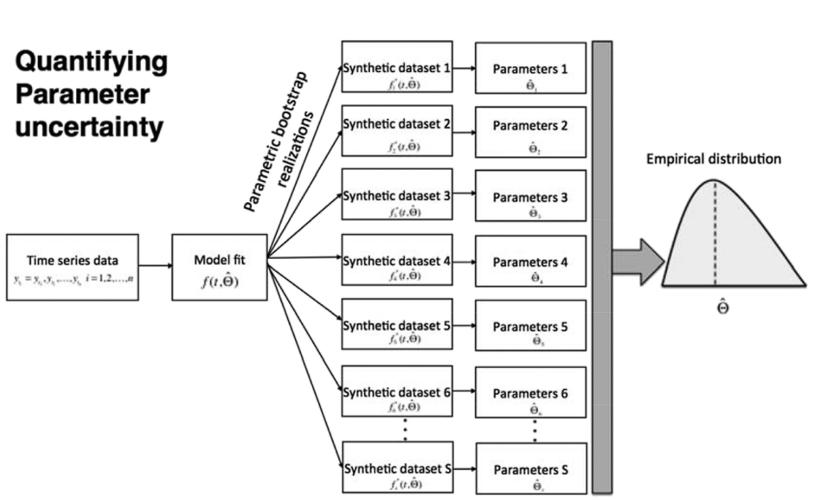
Parameter uncertainty

Slide 8
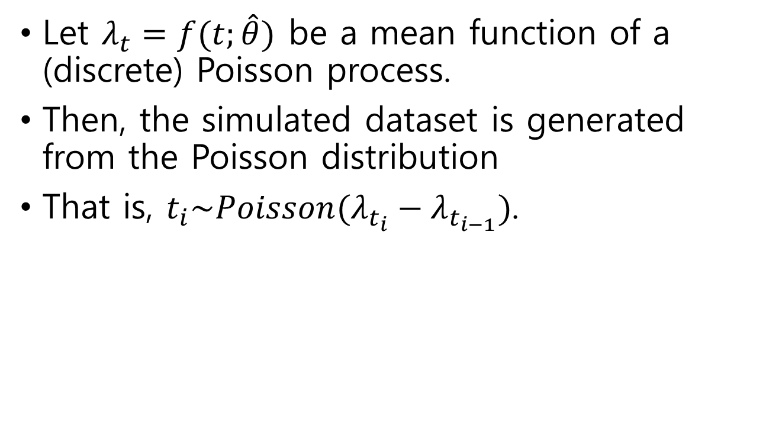
Poisson error structure
Let $λ_{t}=f(t;\hat{θ})$ be a mean function of a (discrete) Poisson process.
Then, the simulated dataset is generated from the Poisson distribution
That is, $t_{i}\sim Poisson(λ_{t_{i}}−λ_{t_{i−1}})$.

Slide 9
Poisson error structure
The models are refitted to the M=200 bootstrap datasets.
Each of the M model solutions to the bootstrap curves is used to generate m=30 simulations.

Slide 10
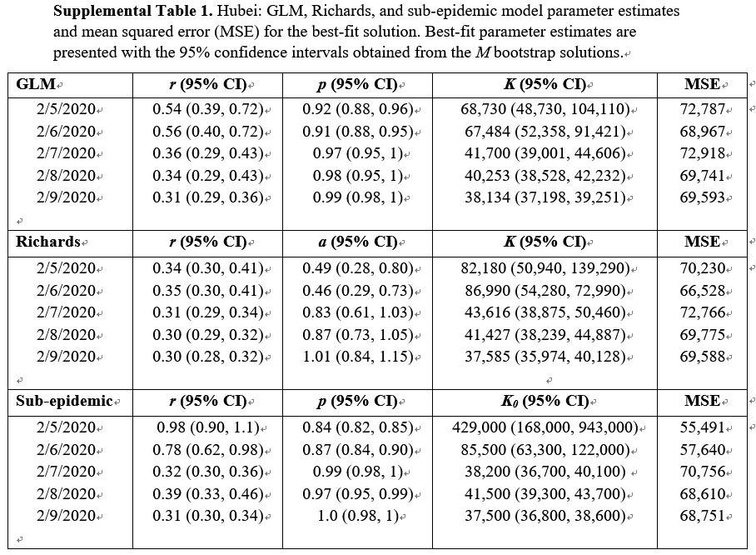
Results

Slide 11
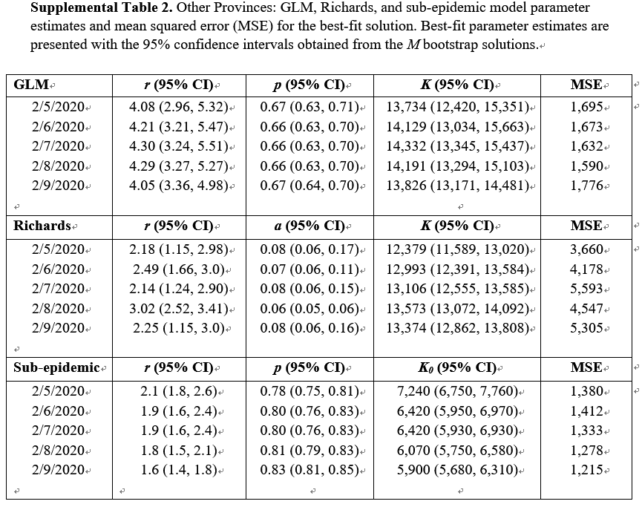
Results

Slide 12
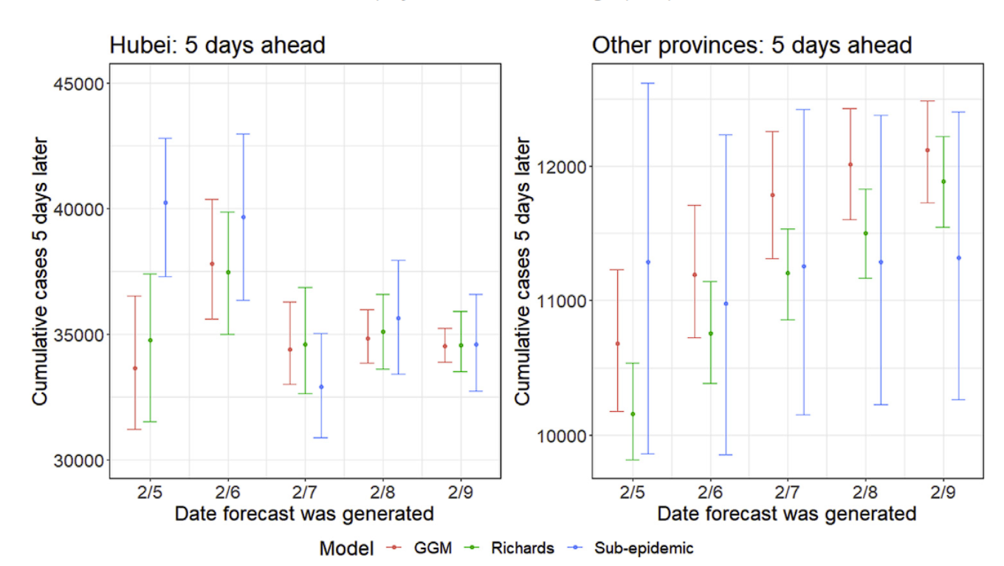
Results

Slide 13
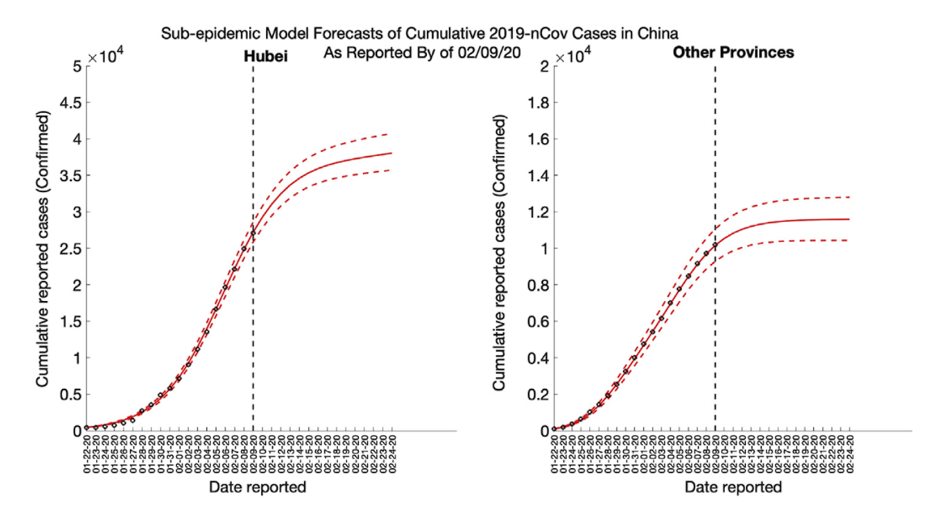
Results

